Slide 1

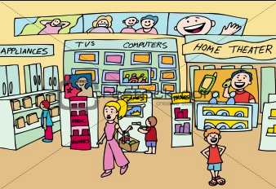
Blackwell Electronics Data Mining Report
Presenter Name : Rakhee Keswani and Matthew Reed
Presentation Date : 05/24/2016

Slide 2


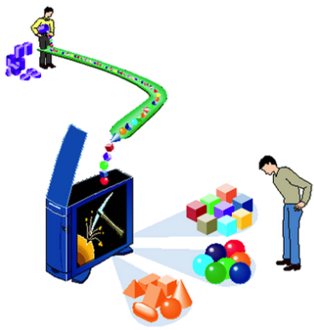
What is Data Mining ?
Making Sense of data
Identifying patterns from large amounts of data

Slide 3
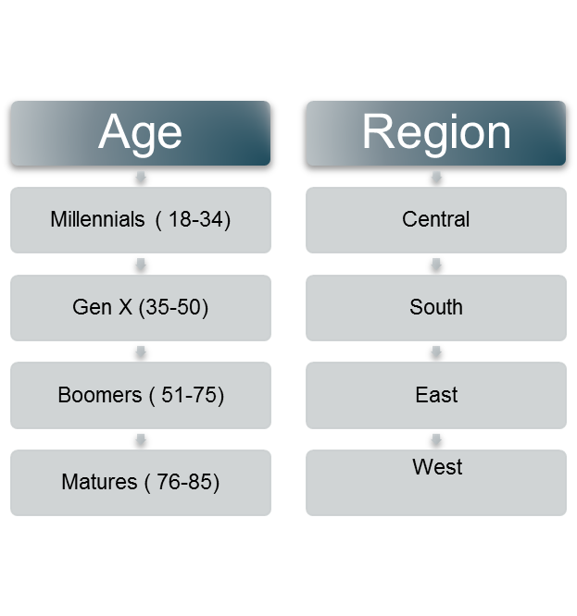
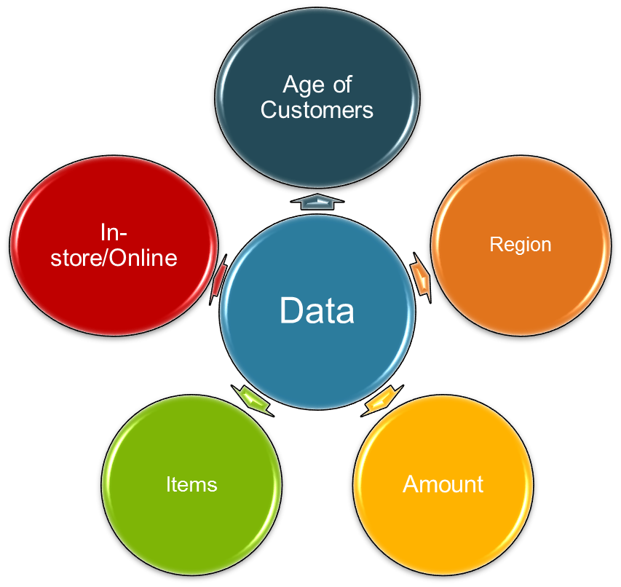
Blackwell Electronics and Data Mining
As data analyst for Blackwell electronics, we were tasked to analyze the sales data and provide insights into the customer buying patterns.

Slide 4
Blackwell Electronics and Data Mining
Relationship between the region of purchase and the amount spent per transaction
Relationship between the region of purchase and a customer’s age
Factors that predict the amount spent per transaction
Correlation between the age of a customer and location of transaction
Provide cross selling product recommendations

Slide 5
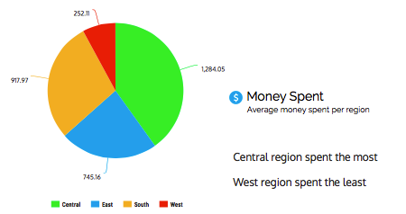
Region of purchase and amount spent

Slide 6
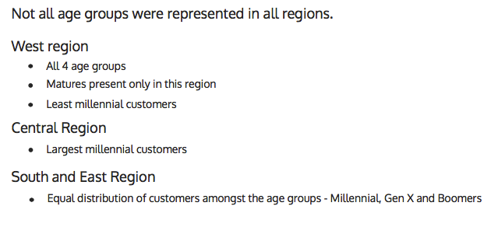
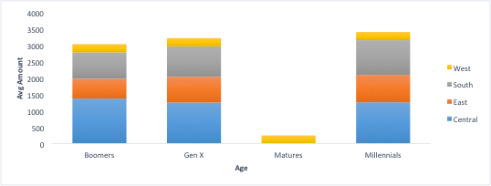
Region of purchase and a customer’s age

Slide 7
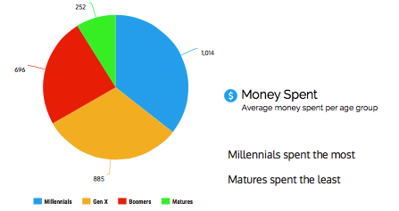
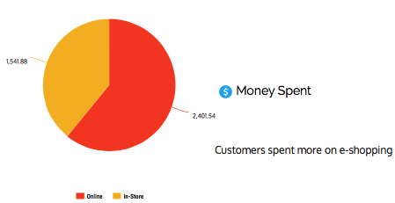
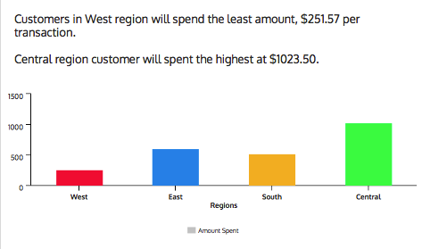
Predict amount spent per transaction

Slide 8
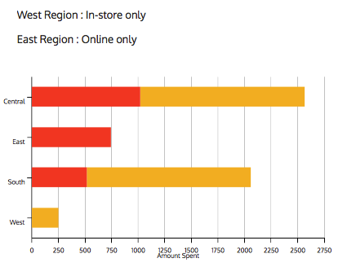
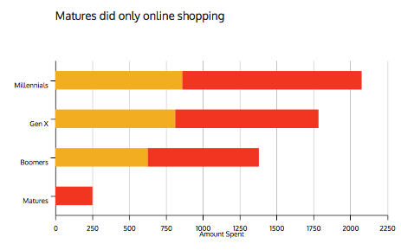
Correlation between age and transaction location

Slide 9
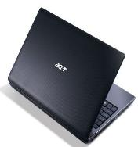



Cross-Selling Recommendations
Online transaction data was analyzed to find correlations and recommended products for cross-selling
ACER Aspire Laptop
Microsoft Office Home & Student 2010
Logitech Desktop MK120
Square Trade 3-Year Computer Accidental Protection Warranty

Slide 10
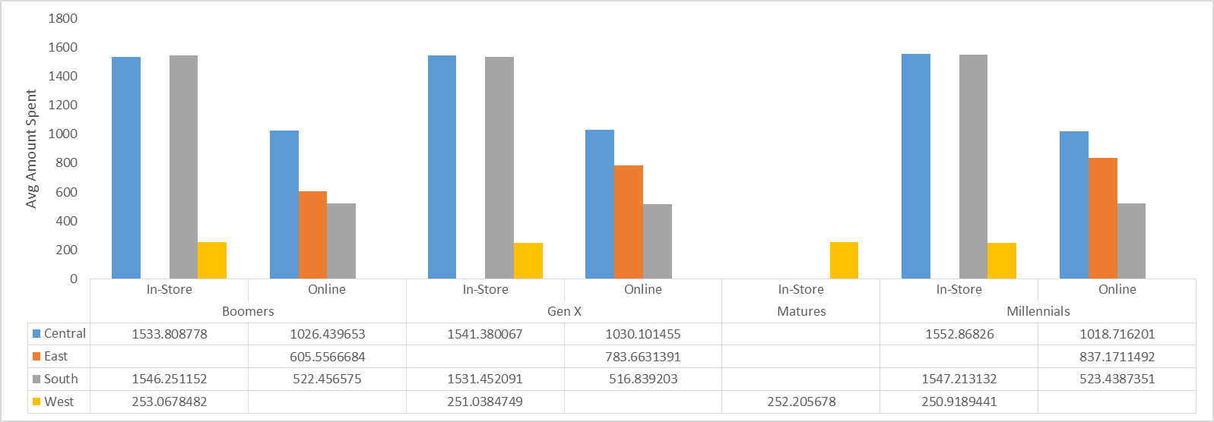
Summary of Analysis
Central region spent the most and West region spent the least.
Age group matures are represented only in West region.
Customers spent more e-shopping.
West region customers did their shopping only in store
East region only online.

Slide 11
Recommendations
Blackwell can create a “Geek Squad” that can teach the older customers how to use the laptop as well as other products.
Come up with marketing strategies in the west region to attract more customers.
Offer more incentives to purchase in-store like price matching, BOGO.
Explore the concept of stores within a store.
Create awareness of online shopping in the west region.
Set up more brick and mortar stores in the east region.

Slide 12
What can data mining help with ?
Churn Analysis : Which customers are more likely to go buy from a competitor ?
Fraud Analysis : Is the transaction a fraud credit card transaction ?
Basket Analysis : Which products are more likely to be purchased together ?
Trend Analysis :What is the difference between a typical customer this month and the previous months ?

Slide 13
Thank You

